Slide 1
Lec - 4

Slide 2

O
F
O
F₁
O
CONVEX
CONCAVE
CONCAVE
Difference between a concave and convex mirror
Concave mirror
Convex mirror
It is made by silvering the outer surface of a part of the hollow sphere, so reflection takes
It is made by silvering the inner surface of the hollow sphere, so reflection takes place
from the bulging surface.
It converges the light rays incident on it after reflection.
It diverges the light rays incident on it after reflection.
The image formed by it is real as well as virtual.
The image formed by it is always virtual for all positions of the object in front of it.

Slide 3
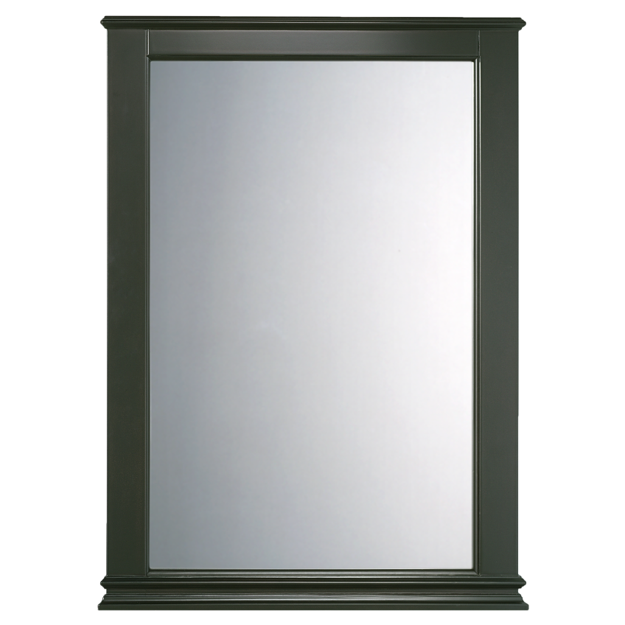


O
F
O
F₁
O
CONVEX
CONCAVE
CONCAVE
DISTINCTION BETWEEN A
PLANE MIRROR, CONCAVE MIRROR AND CONVEX MIRROR
CASE 1
If the image is upright, of same size and it does not change in size by moving the mirror towards or away from the object, then which type of mirror is this?
THE MIRROR IS PLANE

Slide 4
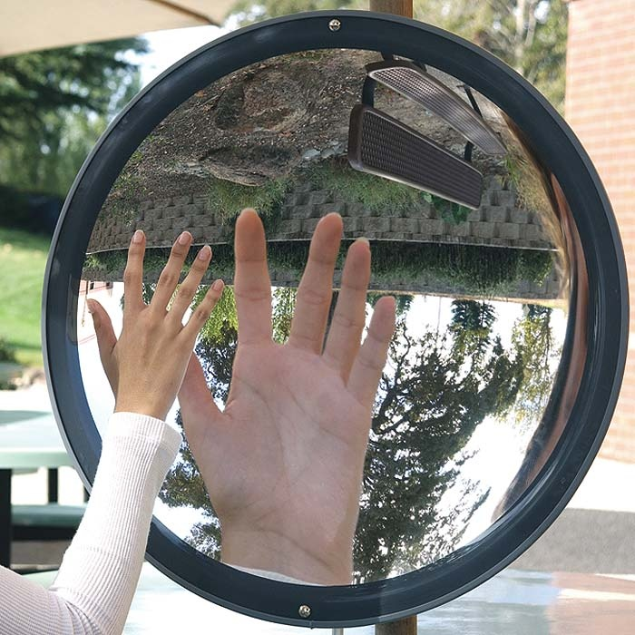
O
F
O
F₁
O
CONVEX
CONCAVE
CONCAVE
DISTINCTION BETWEEN A
PLANE MIRROR, CONCAVE MIRROR AND CONVEX MIRROR
CASE 2
If the image is upright and magnified and increase in size on moving the mirror away, then which type of mirror is this?
THE MIRROR IS CONCAVE

Slide 5
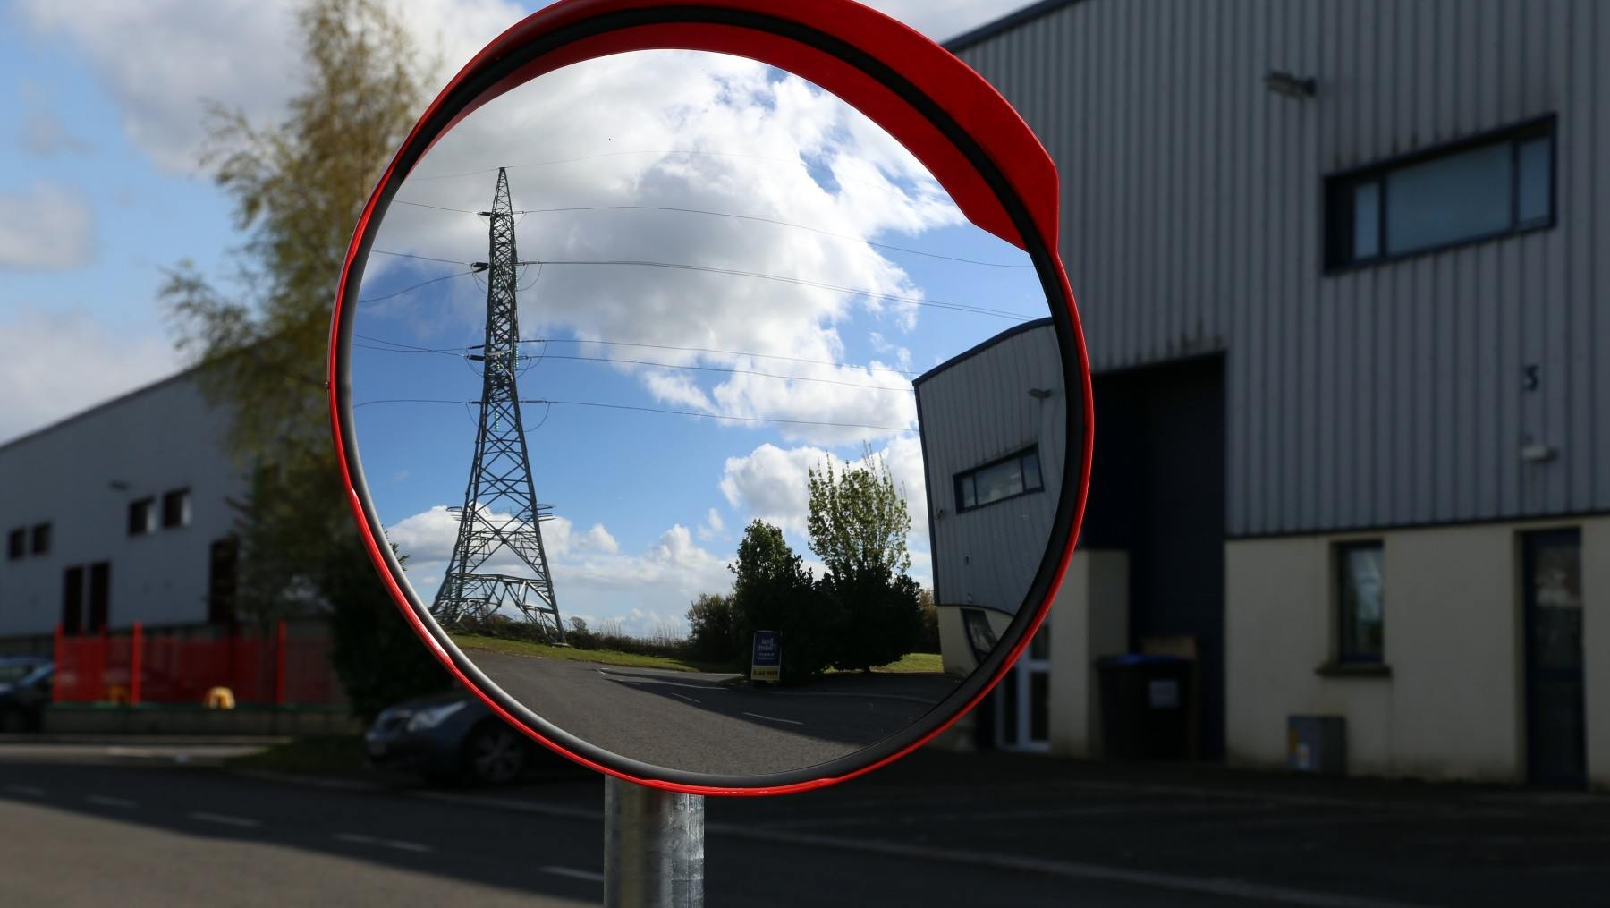
O
F
O
F₁
O
CONVEX
CONCAVE
CONCAVE
DISTINCTION BETWEEN A
PLANE MIRROR, CONCAVE MIRROR AND CONVEX MIRROR
CASE 3
If the image is upright and diminished and decrease in size on moving the mirror away, then which type of mirror is this?
THE MIRROR IS CONVEX

Slide 6


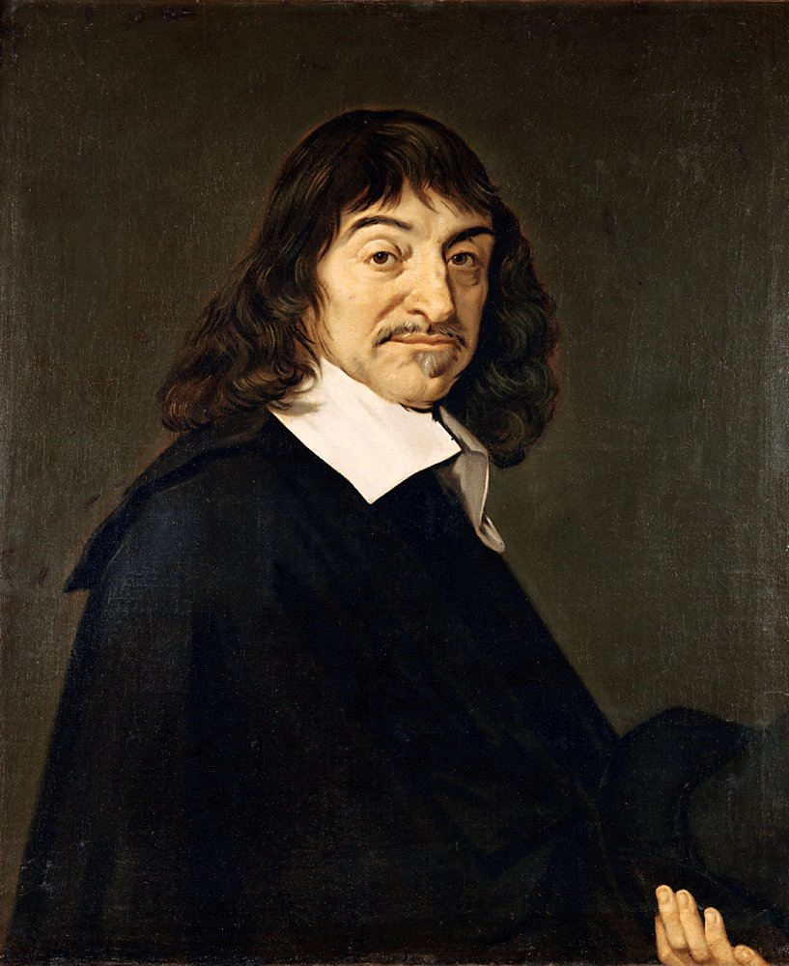
Cartesian sign convention
Y
5
4
3
2
1
X
2F₁
F₁
1
2
3
4
5
2F₂
-5
-4
-3
-2
-1
O
F₂
In front of mirror
-1
Behind the mirror
-2
-3
-4
-5
SIR DESCARTES

Slide 7
Cartesian sign convention
1. Object should be always to the left of the mirror.
(+)
Y
Distance
2. All distances parallel to principal axis are measured from the optical centre of the mirror.
Object
Distance
Distance
A
(–)
B'
(+)
3. The distances to the right of origin are +ve
The distances to the left of origin are –ve
2F₁
B
F₁
O
2F₁
F₁
X
Optical centre
A'
4. The distances measured perpendicular to and above the principal axis are +ve
Distance
Image
(–)
5. The distances measured perpendicular to and below the principal axis are –ve

Slide 8
C
F
P
P
F
C
Cartesian sign convention
1. Object should be always to the left of the mirror.
2. All distances parallel to principal axis are measured from the optical centre of the mirror.
(+)
Y
3. The distances to the right of origin are +ve
The distances to the left of origin are –ve
(-)
(+)
4. The distances measured perpendicular to and above the principal axis are +ve
C
F
P
X
5. The distances measured perpendicular to and below the principal axis are –ve
(-)
6. Focal length of concave mirror is –ve
f
Focal length of convex mirror is +ve

Slide 9
Cartesian sign convention
1. Object should be always to the left of the mirror.
2. All distances parallel to principal axis are measured from the optical centre of the mirror.
(+)
Y
3. The distances to the right of origin are +ve
The distances to the left of origin are –ve
(-)
(+)
4. The distances measured perpendicular to and above the principal axis are +ve
P
F
C
X
5. The distances measured perpendicular to and below the principal axis are –ve
(-)
f
6. Focal length of concave mirror is –ve
Focal length of convex mirror is +ve

Slide 10

Mirror Formula
1
1
1
Magnification (M)
+
=
v
u
f
size of the image
(h₂)
v
Image distance
Magnification
=
size of the object
(h₁)
u
Object distance
f
Focal length
h₂
h₂
M =
=
-
h₁
h₁

Slide 11
Mirror Formula
v
Image distance
1
1
1
+
=
v
u
u
Object distance
f
f
Focal length
Magnification (M)
size of the image
(h₂)
Magnification
=
size of the object
(h₁)
h₂
h₂
M =
=
-
h₁
h₁

Slide 12

TYPE - A
PROBLEMS BASED ON THE
FORMULA
ALWAYS REMEMBER
1
1
1
u : always -ve
+
=
v
u
f
f _{(convex)} : +ve
f _{(concave)} : -ve

Slide 13
1
An object is placed at a distance of 36 cm from a concave mirror of focal length 12 cm. Find the image distance.
Given :
Object distance (u)
= -36 cm
= -12 cm
A
Focal length (f)
To Find :
Image distance (v)
= ?
B^{I}
f = 12 cm
B
C
F
P
1
1
1
Formula :
+
=
u = 36 cm
v
u
f
1
1
1
v = ?
Solution :
=
-
A^{I}
v
f
u
1
1
1
∴
=
-
v
-12
-36
∴ v = -18 cm
The image is formed at a distance
of 18 cm in front of the mirror.
1
-1
1
1
-2
∴
=
+
∴
=
v
12
36
v
36
1
-3 + 1
1
1
∴
=
∴
=
v
36
v
-18

Slide 14
2
At what distance from a concave mirror of focal length 10 cm should an object be placed, so that image is formed 20 cm behind the mirror.
Given :
Focal length (f)
= -10 cm
A^{I}
= 20 cm
A
Image distance (v)
?
20 cm
To Find :
Object distance (u)
= ?
C
F
B
P
B^{I}
Formula :
1
1
1
+
=
v
u
f
10 cm
Solution :
1
1
1
=
-
u
f
v
1
-3
The object is placed at a distance of 6.67 cm in front of the concave mirror.
1
1
1
∴
=
∴
=
-
u
20
u
-10
20
∴
-20
1
-2 - 1
u =
∴
=
3
u
20
∴ u = -6.67 cm

Slide 15
3
An object placed 20 cm in front of a convex mirror is found to have an image 15 cm behind the mirror. Find the focal length of the mirror.
Given :
Object distance (u)
= -20 cm
A
A^{I}
Image distance (v)
= 15 cm
20 cm
15 cm
To Find :
Focal length (f)
= ?
B
P
B^{I}
F
C
Formula :
1
1
1
?
+
=
v
u
f
1
1
1
The focal length of the convex mirror is 60 cm.
Solution :
+
=
15
(-20)
f
1
1
1
1
1
∴
-
=
∴
=
15
20
f
60
f
4 - 3
1
∴ f = 60 cm
=
=
60
f

Slide 16
4
An image is formed 5 cm behind a convex mirror of focal length 10 cm. At what distance is the object placed from the mirror ?
Given :
Image distance (v)
= 5 cm
A
A^{I}
?
5 cm
Focal length (f)
= 10 cm
To Find :
Object distance (u)
= ?
B
P
B^{I}
F
C
1
1
1
10 cm
Formula :
+
=
v
u
f
Solution :
1
1
1
=
-
The object is placed in front of the convex mirror at a distance of 10 cm.
u
f
v
1
1
1
∴
=
-
u
10
5
1
1
-
2
∴
=
u
10
1
-1
∴
=
∴ u = - 10 cm
u
10

Slide 17
*5
An object is placed at a distance of 10 cm from a convex mirror of focal length 15 cm. Find the position and nature of the image.
Given :
Object distance (u) = -10 cm
Focal length (f) = 15 cm
A
A^{I}
To Find :
Image position and nature
Formula :
1
1
1
B
P
B^{I}
F
C
+
=
v
u
f
object distance = 10 cm
Focal length = 15 cm
Solution :
1
1
1
+
=
1
v
-10
15
5
1
1
1
Since image distance 6 cm which is positive, image is formed behind the mirror. Thus nature is virtual and erect
∴
1
25
-
=
∴
=
v
10
15
v
15 × 10
2
1
1
1
3
∴
=
+
1
1
v
(15)
10
∴
=
v
6
1
10 + 15
∴
=
∴ v = 6 cm
v
15 × 10

Slide 18
6
An arrow is placed at a distance of 25 cm from a diverging mirror of focal length 20 cm. Find the image distance.
∴ v = 11.1 cm

Slide 19

An arrow is placed at a distance of 25 cm from a diverging mirror of
focal length 20 cm. Find the image distance.
5
A
A^{I}
Given :
Object distance (u)
= -25 cm
Focal length (f)
= 20 cm
25 cm
?
B
P
B^{I}
F
C
To Find :
Image distance (v)
= ?
20 cm
1
1
1
Formula :
+
=
1
25 + 20
1
9
v
u
f
∴
=
∴
=
v
20 × 25
v
100
1
1
1
Solution :
+
=
v
u
f
100
9
1
45
∴
v =
1
1
1
∴
=
9
=
-
v
v
f
u
20 × 25
5
∴ v = 11.1 cm
1
1
1
∴
=
-
v
20
(-25)
Ans: The image is formed at a distance of
11.1 cm behind the mirror.
1
1
1
∴
=
+
v
20
25

Slide 20
Thank You

